Slide 1
string.h
Online Class

Slide 2
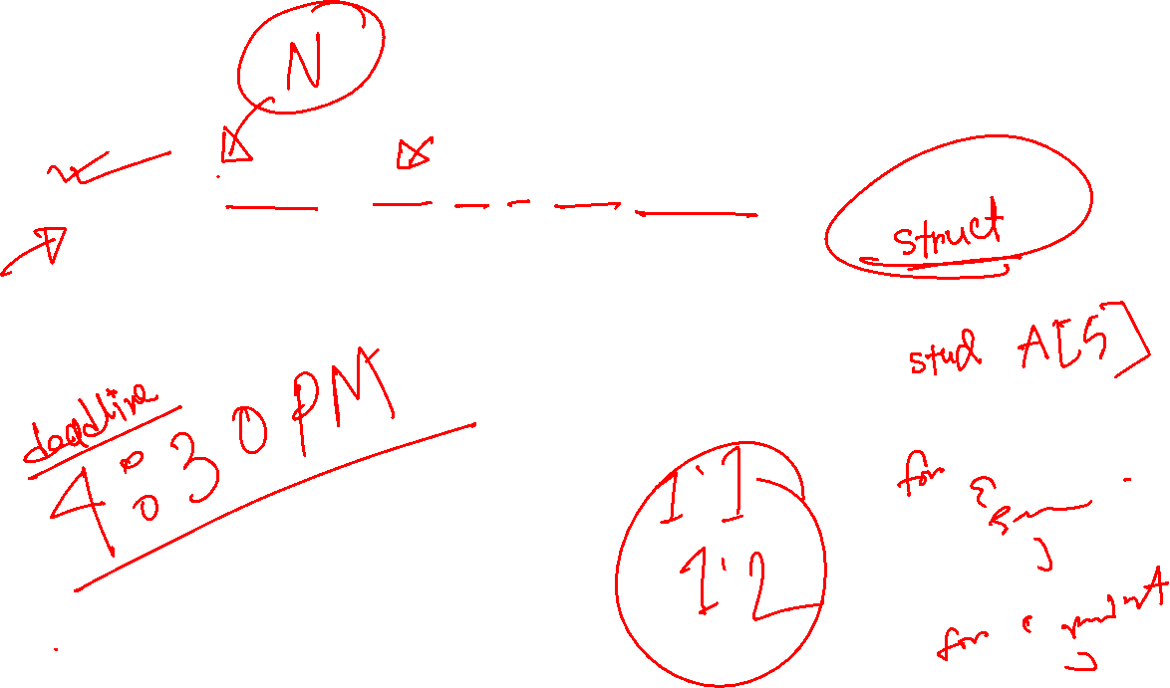
Write a program that
Declares 5 student with name, roll, ID, CGPA, semester
Take inputs using loop
Show the output of student list

Slide 3


Slide 4


Slide 5


